Slide 1
Human Resource Management
PMI Knowledge Areas

Slide 2
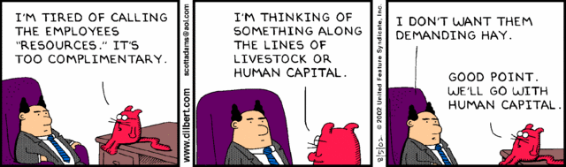
The Importance of Human Resource Management
Many corporate executives have said, “People are our most important asset”
People determine the success and failure of organizations and projects

Slide 3
The Global IT Workforce
Although there have been ups and downs in the IT labor market, there will always be a need for good IT workers
The Digital Planet 2010 study predicts that ICT spending will have an annual growth rate of more than 6 percent each year through 2013, when it will reach almost $5 trillion
Thirty-three percent of the world’s population is online, and 45 percent of Internet users are below the age of 25

Slide 4
What is Project Human Resource Management?
Making the most effective use of the people involved with a project
Processes include
Plan human resource management (Planning)
Acquiring the project team (Executing)
Developing the project team (Executing)
Managing the project team (Control/Monitor)

Slide 5
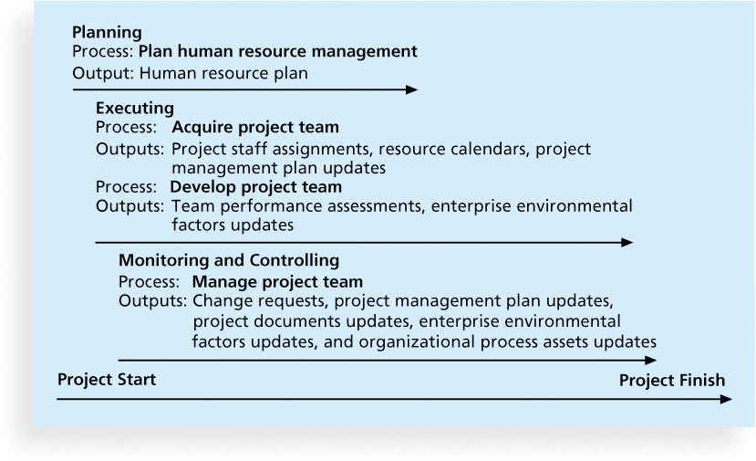
Figure 9-1. Project Human Resource Management Summary

Slide 6
Keys to Managing People
Psychologists and management theorists have devoted much research and thought to the field of managing people at work
Important areas related to project management include:
motivation theories
influence and power
effectiveness

Slide 7
Ways to Influence that Help and Hurt Projects
Projects are more likely to succeed when project managers influence with
Projects are more likely to fail when project managers rely too heavily on

Slide 8
Power
Power is the potential ability to influence behavior to get people to do things they would not otherwise do
Types of power

Slide 9
Planning Process Group: Developing the Human Resource Plan
Used to determine the roles that will perform schedule activities and to develop the staff management plan to fill the roles with team members
Contents include
project organizational charts
staffing management plan
responsibility assignment matrixes
resource histograms

Slide 10
Inputs: Enterprise Environmental Factors
How do different departments and the people within the performing organization interact with each other?
Enterprise Environmental Factors to consider

Slide 11
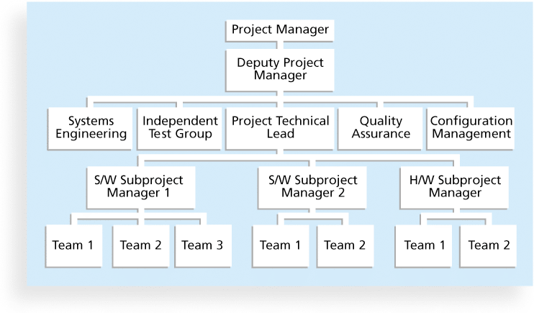
Sample Organizational Chart for a Large IT Project

Slide 12
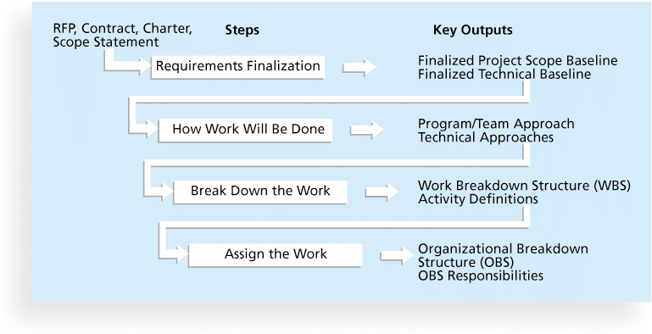
Work Definition and Assignment Process

Slide 13
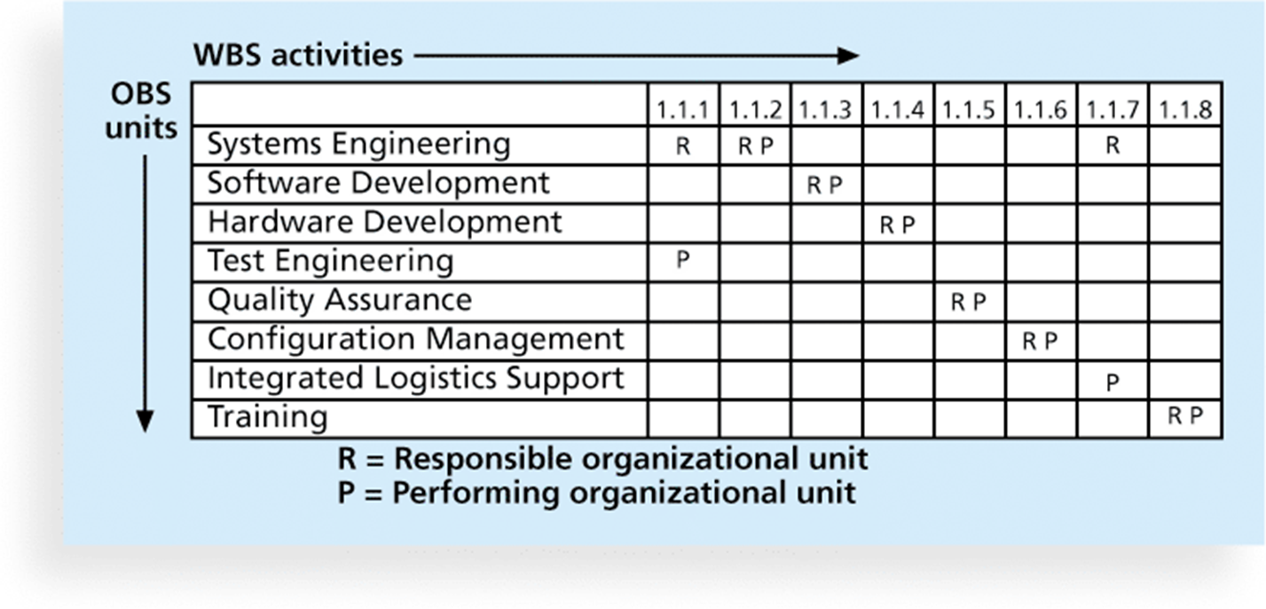
Responsibility Assignment Matrices
A responsibility assignment matrix (RAM) is a matrix that maps the work of the project as described in the WBS to the people responsible for performing the work as described in the OBS

Slide 14
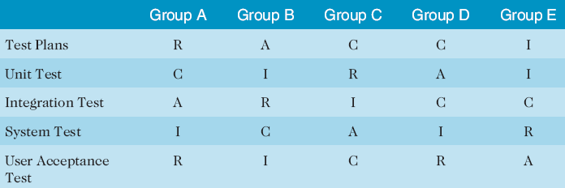
Sample RACI Chart
R = responsibility
A = accountability, only one A per task
C = consultation
I = informed

Slide 15
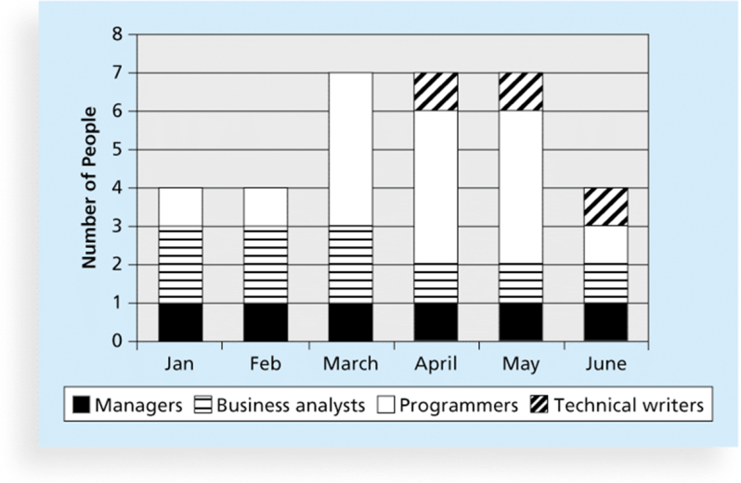
Staffing Management Plans and Resource Histograms
A staffing management plan describes when and how people will be added to and taken off the project team
A resource histogram is a column chart that shows the number of resources assigned to a project over time

Slide 16
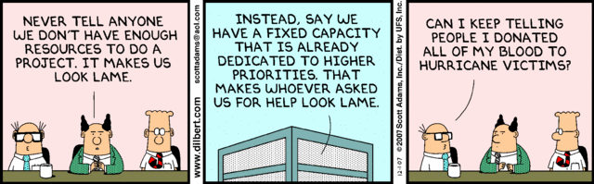
Planning Process Group: Acquiring the Project Team
Acquiring qualified people for teams is crucial
It’s important to assign the appropriate type and number of people to work on projects at the appropriate times

Slide 17
Inputs into Acquiring Team
Human Resource Plan
Enterprise Environmental Factors
Availability
Competency
Experience
Interests
Cost

Slide 18
Resource Assignment
Staffing plans and good hiring procedures are important, as are incentives for recruiting and retention
Do your homework
What happens when you don’t?

Slide 19
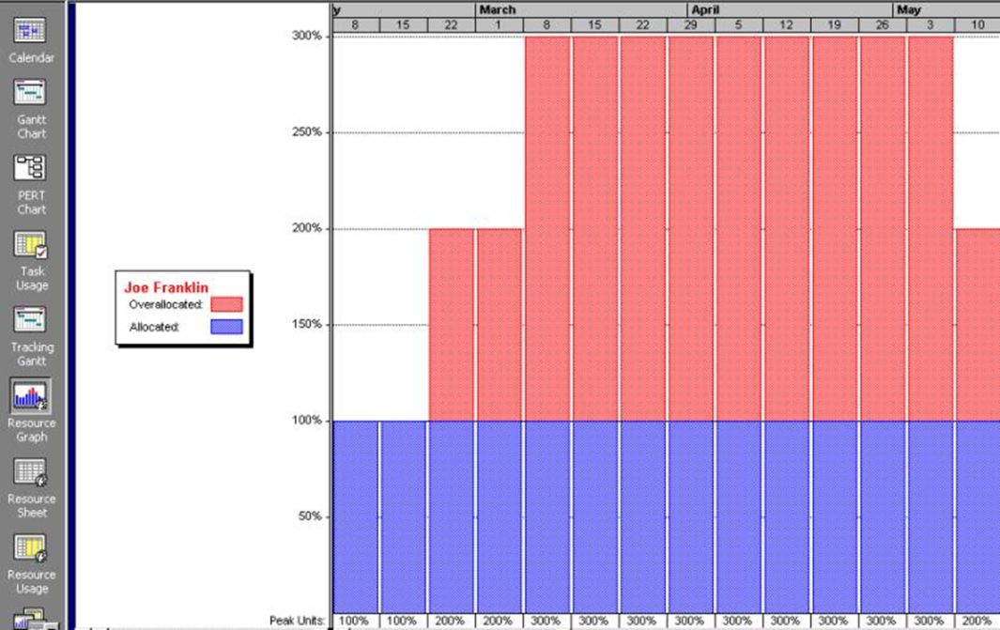
Be Aware of Resource Loading
Resource loading
Helps project managers develop a general understanding of the demands a project will make on the organization’s resources and individual people’s schedules
Overallocation

Slide 20
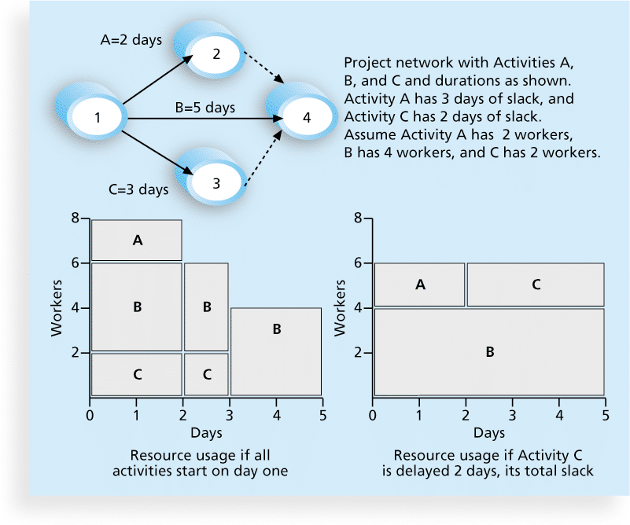
Resource Leveling
Resource leveling is a technique for resolving resource conflicts by delaying tasks

Slide 21
Benefits of Resource Leveling
When resources are used on a more constant basis, they require less management
It may enable project managers to use a just-in-time inventory type of policy for using subcontractors or other expensive resources
It results in fewer problems for project personnel and accounting department
It often improves morale

Slide 22
Planning Process Group: Developing the Project Team
The main goal of team development is to help people work together more effectively to improve project performance
Team Development (progressive stages)

Slide 23
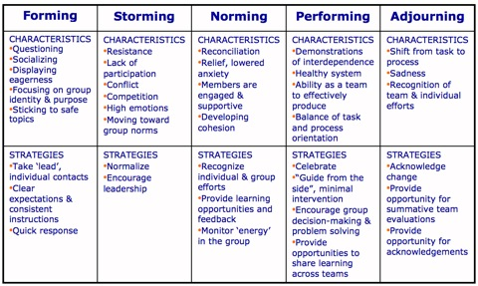
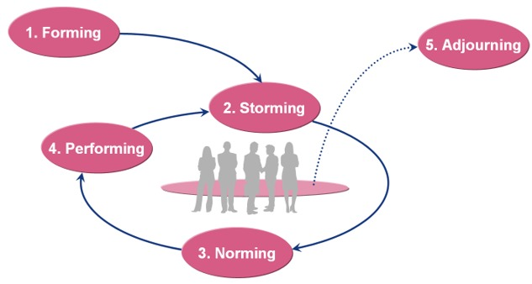
Developing the Project Team

Slide 24
DISC Profiles
Also uses a four-dimensional model of normal behavior
Dominance
Influence
Steadiness
Compliance
People in opposite quadrants can have problems understanding each other

Slide 25
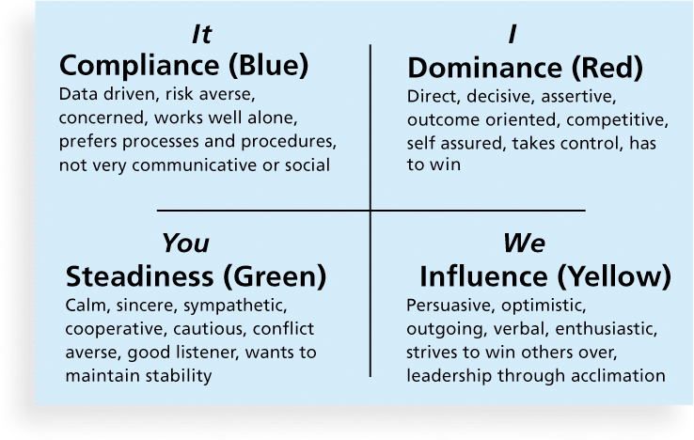
Figure 9-10. The DISC Profile

Slide 26
Reward and Recognition Systems
Team-based reward and recognition systems can promote teamwork
Focus on rewarding teams for achieving specific goals
Allow time for team members to mentor and help each other to meet project goals and develop human resources

Slide 27
Control/Monitoring Process Group: Managing the Project Team
Project managers must lead their teams in performing various project activities
After assessing team performance and related information, the project manager must decide:
if changes should be requested to the project
if corrective or preventive actions should be recommended
if updates are needed to the project management plan or organizational process assets.

Slide 28
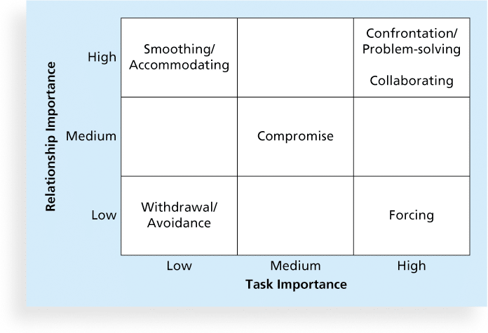
Conflict Handling Modes
Confrontation
Compromise
Smoothing
Forcing
Withdrawal
Collaborating
http://www.youtube.com/watch?v=6xCkhV7zhuw

Slide 29
Conflict Can Be Good
Conflict often produces important results, such as new ideas, better alternatives, and motivation to work harder and more collaboratively
Research suggests that task-related conflict often improves team performance, but emotional conflict often depresses team performance
Tips for Resolving Conflicts

Slide 30
Common Sources of Conflict
Work scope
Resource assignments
Schedule
Costs
Technical opinions
Priorities of resource time
Administrative procedures
Responsibilities
Personality clashes

Slide 31
Root Cause of Conflict
The PM has final responsibility to resolve or manage any conflict that affects project success.
For example, suppose two people are yelling at each other during a meeting. Asking them to not yell fixes the symptom, but not the root cause of the conflict, which may be a difference of opinion about an issue due to different assumptions being made by each person.

Slide 32
Five Dysfunctions of a Team
The five dysfunctions of teams are
Absence of trust
Fear of conflict
Lack of commitment
Avoidance of accountability
Inattention to results
*Lencioni, Patrick, “Overcoming the Five Dysfunctions of a Team,” Jossey-Bass: San Francisco, CA (2005), p. 3.

Slide 33
General Advice on Teams
Be patient with your team
Fix the problem instead of blaming people
Establish regular, effective meetings
Allow time for teams to go through the basic team-building stages
Limit the size of work teams to three to seven members

Slide 34
Using Software to Assist in Human Resource Management
Software can help in producing RAMS and resource histograms
Project management software includes several features related to human resource management such as
Assigning resources
Identifying potential resource shortages or underutilization
Leveling resources

Slide 35
Project Resource Management Involves Much More Than Using Software
Project managers must
Treat people with consideration and respect
Understand what motivates them
Communicate carefully with them
Focus on your goal of enabling project team members to deliver their best work

Slide 36
Chapter Summary
Project human resource management includes the processes required to make the most effective use of the people involved with a project
Main processes include
Plan human resource management
Acquire project team
Develop project team
Manage project team

Slide 37
CAPM Sample Question
Which of the following is generally the best conflict-resolution technique in most cases?
Avoidance
Compromise
Accommodation
Collaboration

Slide 38
CAPM Sample Question
Karl, one of your team members, is arguing with you over how to perform a specific task. At the end of a long discussion, you say “ Karl, please do me a favor and do it this way for my peace of mind.” Which conflict resolution technique are you using?
Avoidance
Compromise
Accommodation
Forcing

Slide 39
CAPM Sample Question
Management has asked you to produce a chart that depicts the resource assignments for all the activities in the project. Which of the following charts is management referring to?
Project Organizational Chart
WBS
Roles and Responsibilities Chart
Responsibility Assignment Matrix

Slide 40
CAPM Sample Question
Virtual Teams are a tool and technique used in which of the following processes?
Develop Human Resource Plan
Develop Project Team
Acquire Project Team
Manage Project Team

